Slide 1
The Agricultural Wave
Begins: 10,000 to 12,000 BP
Continues Today

Slide 2
Four Forms of Agriculture
Horticulture
Plow Agriculture
Industrialized Agriculture
4. Organic, Small-Scale Agriculture

Slide 3
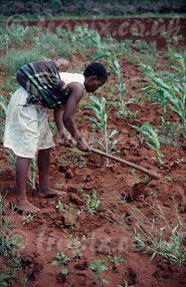
1. Horticulture
Notes:
Horticulture, women plant and tend the crops with simple tools.

Slide 4
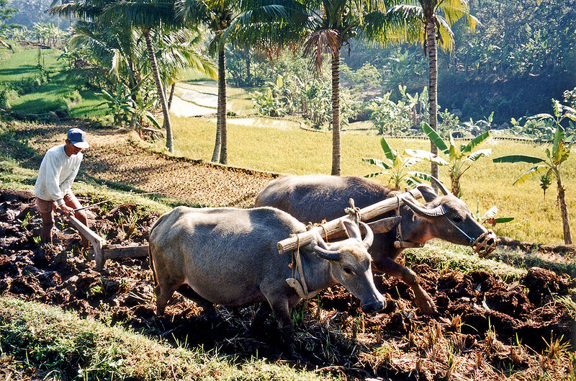
2. Plow Agriculture
Notes:
Plowing rice paddies with water buffalo, in Indonesia. Plow agriculture first developed in the Urban Wave, see chapter 6. Wikimedia Commons

Slide 5
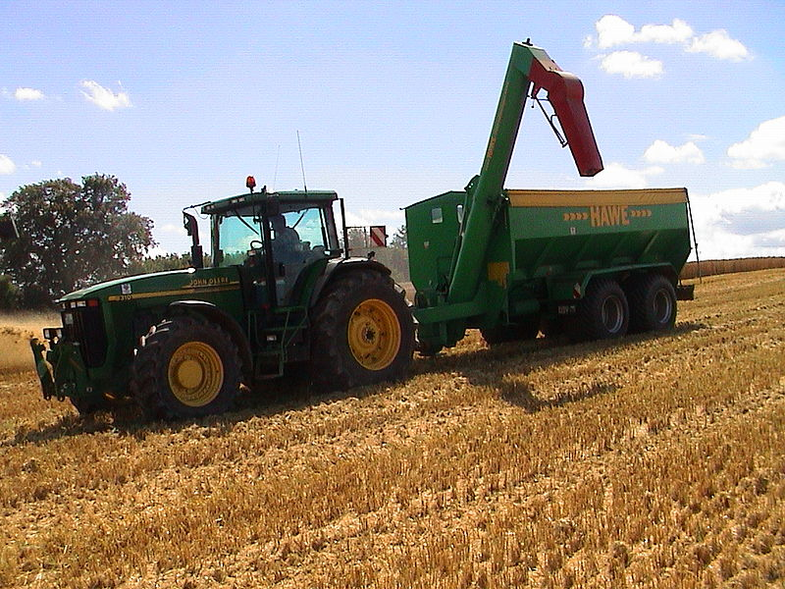
3. Industrialized Agriculture
Notes:
Industrialized agriculture later in the Modern Wave. Wikimedia Commons

Slide 6
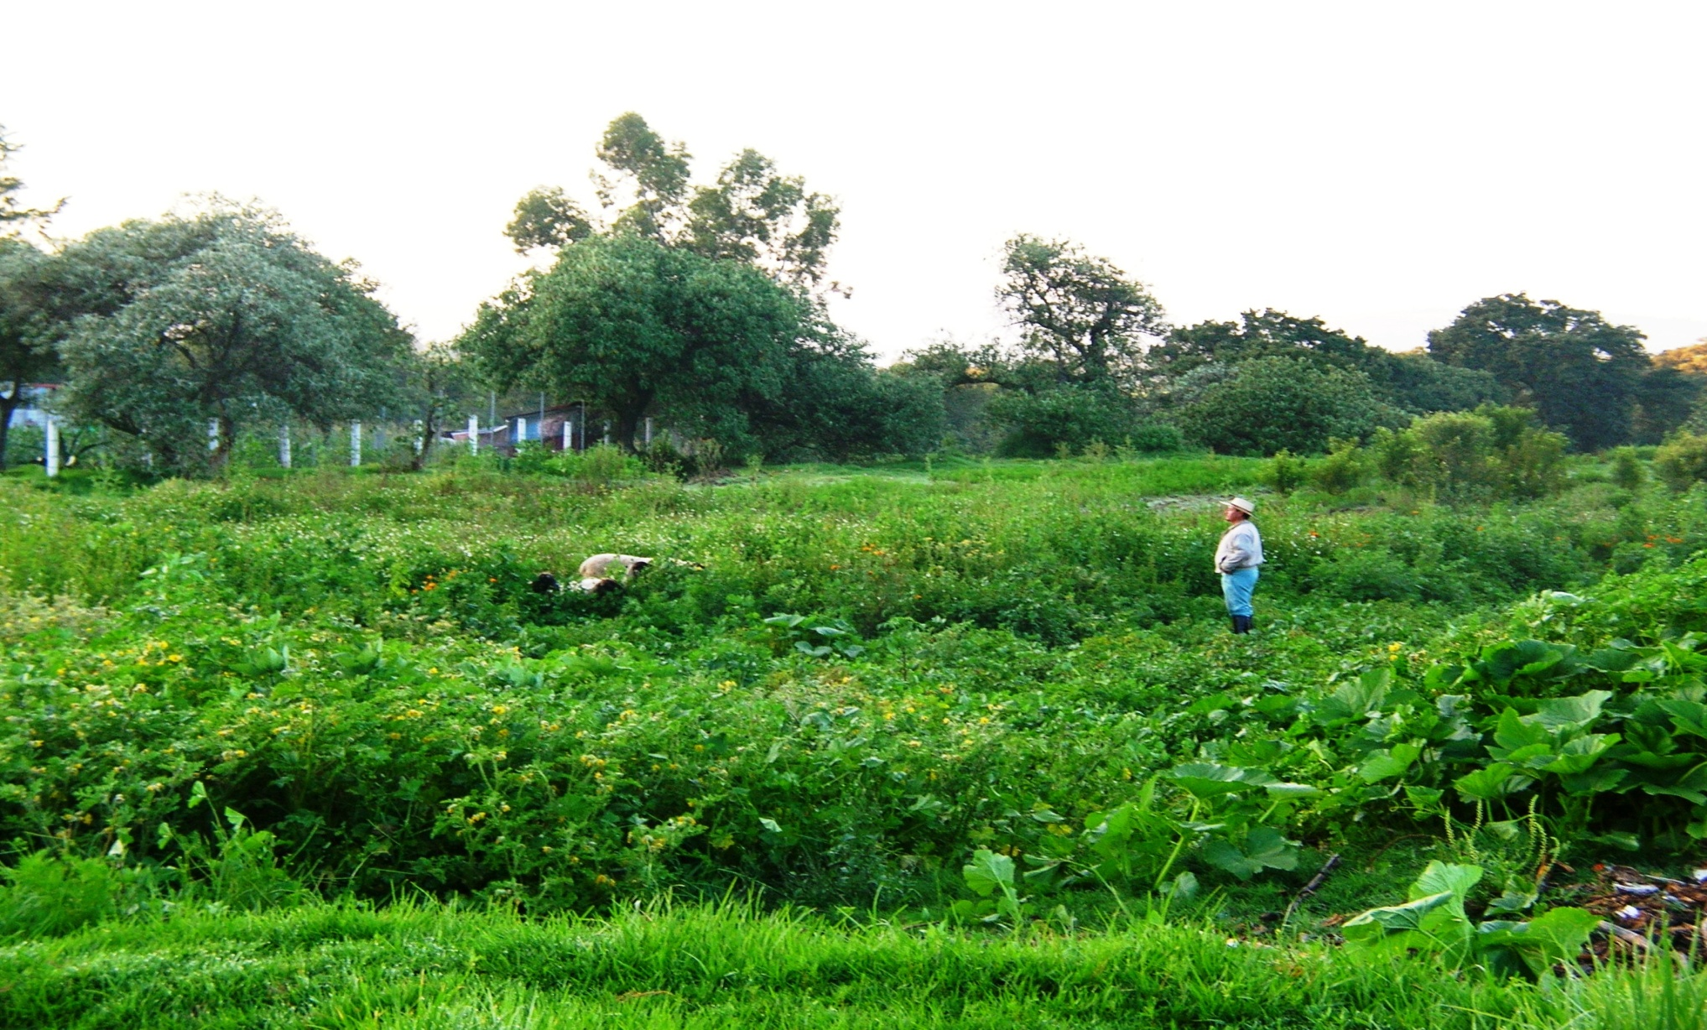
4. Organic, Small-Scale Agriculture
Notes:
Organic, local, small-scale agriculture in the village of Vincente Guerreo, Mexico. Starting in the Global Wave. Photo Denise Ames

Slide 7
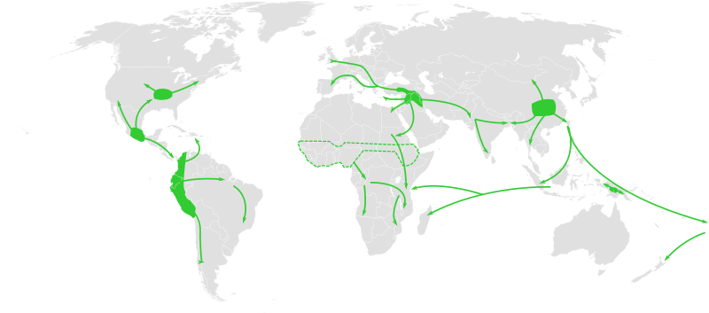
Centers of Origin and Spread of Agriculture
Notes:
Map of the world showing approximate centers of origin of agriculture and its spread in prehistory: the Fertile Crescent (11,000 BP), the Yangtze and Yellow River basins (9000 BP) and the New Guinea Highlands (9000–6000 BP), Central Mexico (5000–4000 BP), Northern South America (5000–4000 BP), sub-Saharan Africa (5000–4000 BP, exact location unknown), eastern USA (4000–3000 BP).

Slide 8
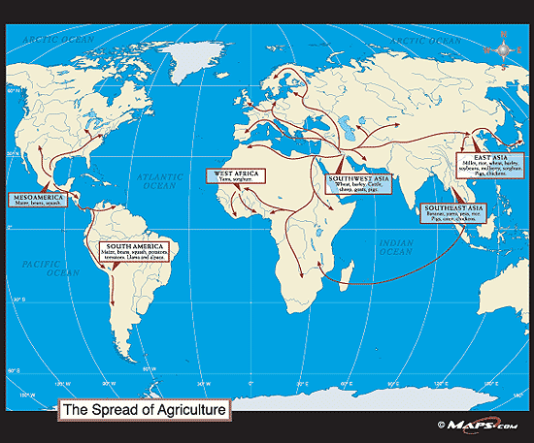
Spread of Agriculture

Slide 9
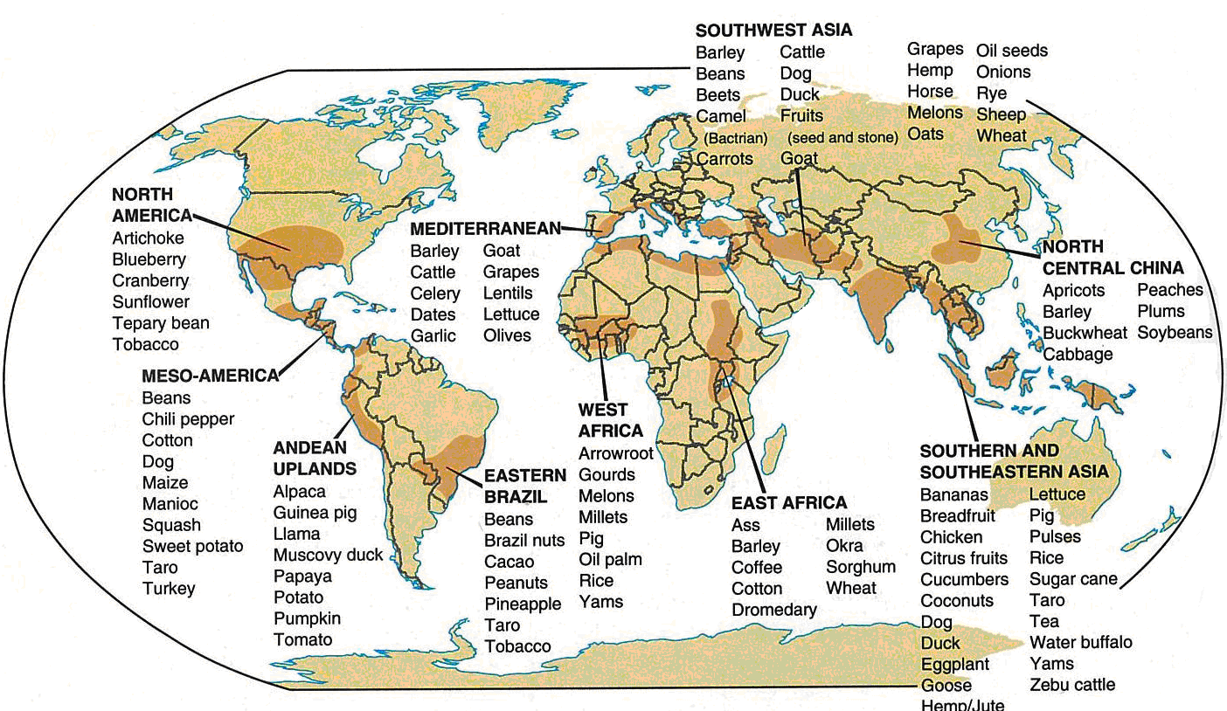
Notes:
Origins of the world’s food crops and domesticated animals. (Not to be reproduced.)

Slide 10
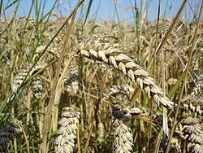
Einkorn Wheat
Notes:
Einkorn wheat was first domesticated in southwest Asia, the hilly flank area of the Zagros Mountains, area now in Turkey

Slide 11
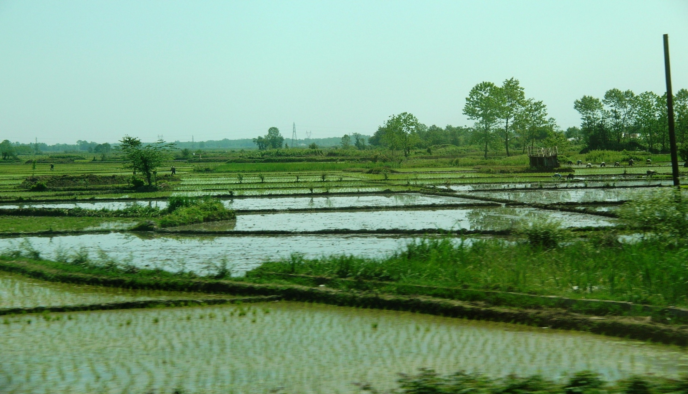
Wet-field Rice Cultivation
Notes:
In northern Iran. Began in earnest in southeast Asia by about 5,000 BP. Photo: Denise Ames

Slide 12

Red and Green Chili Peppers
Notes:
Grown in southern New Mexico, USA. Photo Denise Ames

Slide 13
The Transition to Agriculture
Theory of Progress
Oasis Hypothesis
Hilly Flank Theory
Survival Theory
Marginal Zone (Edge Hypothesis)
Population Theory
Co-evolutionary Theory
Social Explanations

Slide 14
Relationship with Nature:
Ecosystem Currents
Geography
Environment
Human Population
Natural Population
Human and Nature Interaction

Slide 15
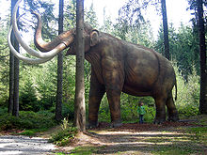
Wooly Mammoth
Notes:
As a result of a warming trend the wooly mammoth became extinct between 9,000 and 15,000 BP. Full size reconstruction of a mammoth.

Slide 16
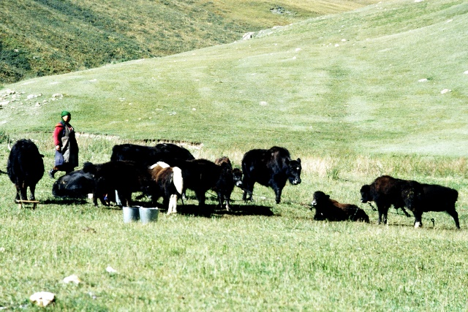
Grazing Yak
Notes:
Grazing yak, Wikimedia Commons

Slide 17
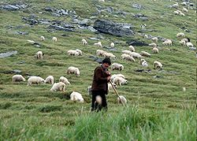
Shepherd
Notes:
Shpherd in Fagaras Mountains, Romania. Wikimedia Commons

Slide 18
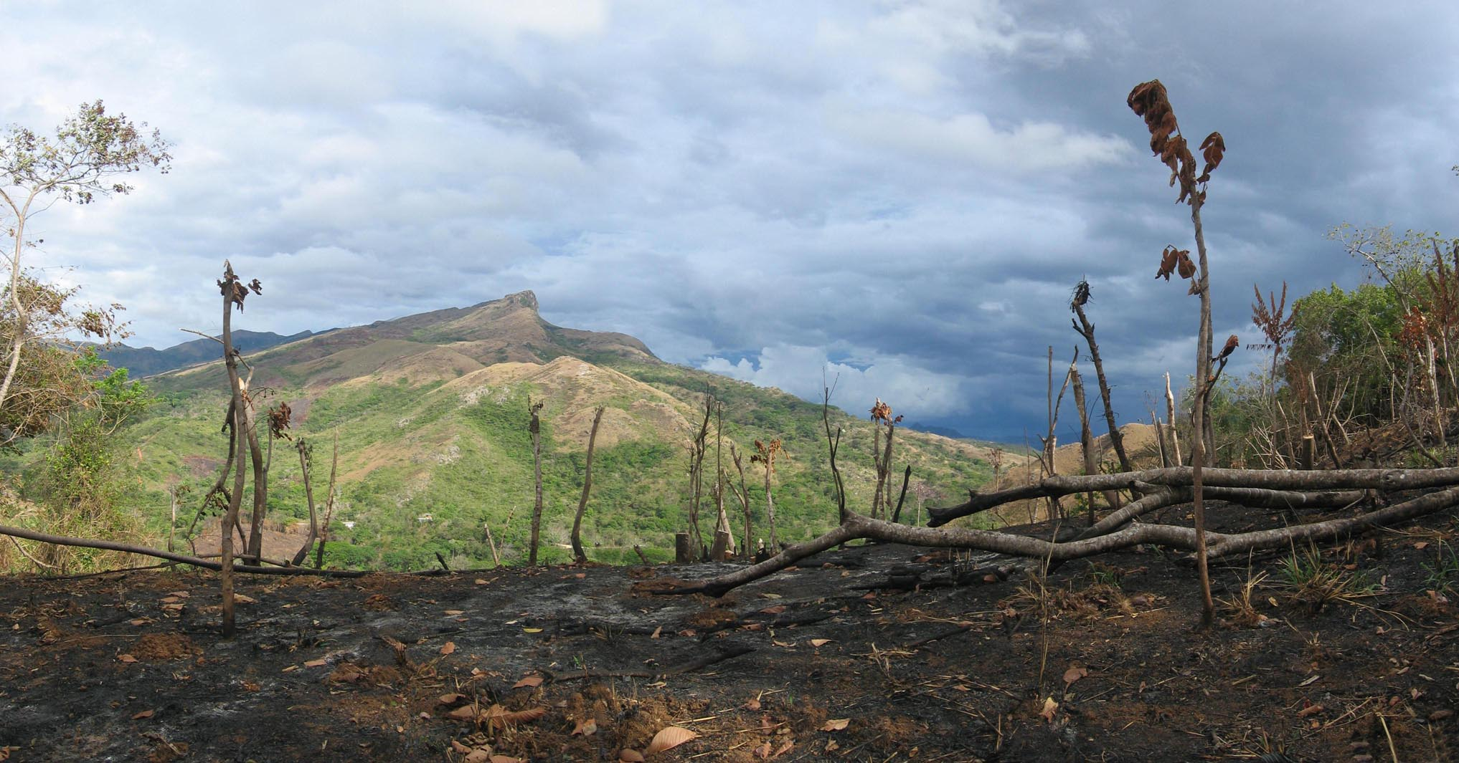
Slash and Burn Agriculture
Notes:
Slash and burn agriculture causes erosion.

Slide 19
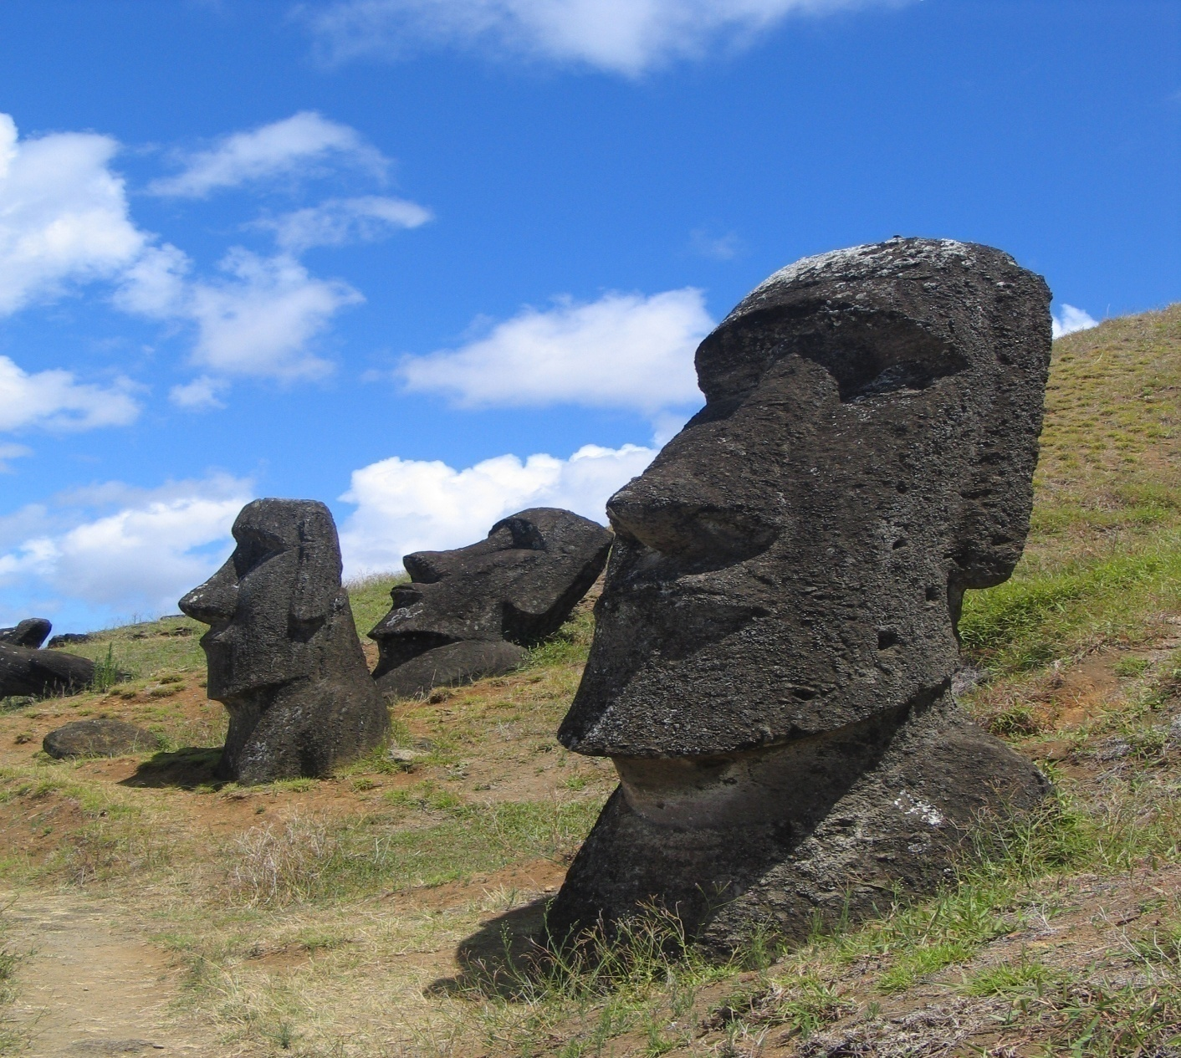
Easter Island
Notes:
Is a Polynesian island in the southeastern Pacific Ocean. Easter Island is famous for its 887 extant monumental statues, called moai, created by the early Rapanui people.

Slide 20
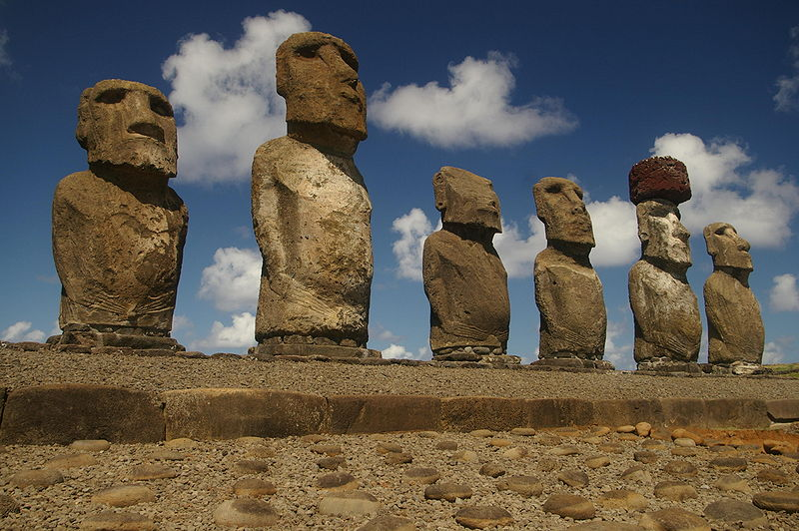
Easter Island

Slide 21
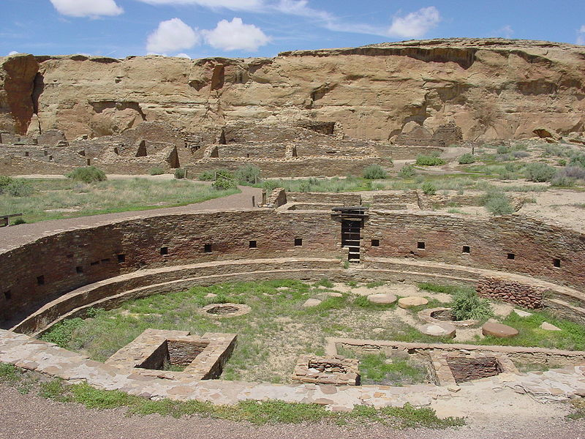
Chaco Canyon
Notes:
Between AD 900 and 1150, Chaco Canyon was a major center of culture for the Ancient Pueblo Peoples. Climate change is thought to have led to the emigration of Chacoans and the eventual abandonment of the canyon, beginning with a fifty-year drought commencing in 1130.

Slide 22
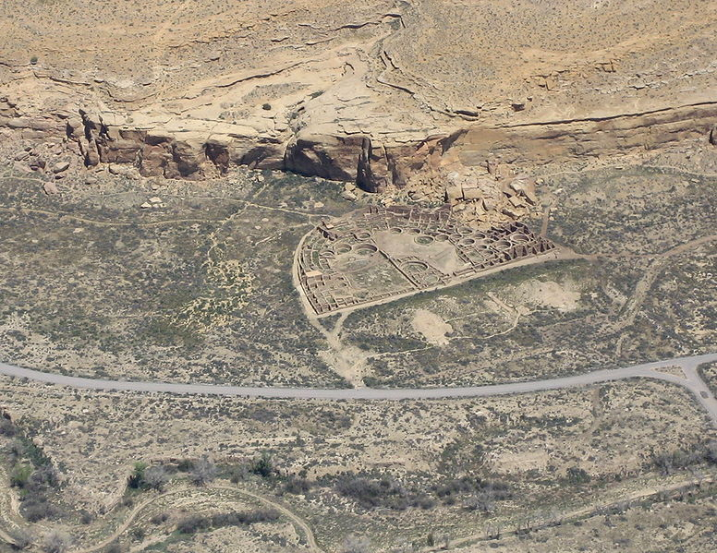
Chaco Canyon
Notes:
Aerial view. Located in present day northern New Mexico, USA

Slide 23
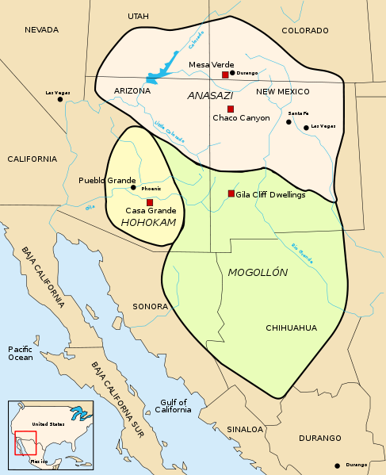
Anasazi Sites
Notes:
Anasazi (ancient puebloan) sites in the Southwest USA.

Slide 24
Ways of Living:
Techno-Economic Currents
Daily Life
Economic Systems
Technology
Patterns of Labor
Exchange and Trade

Slide 25
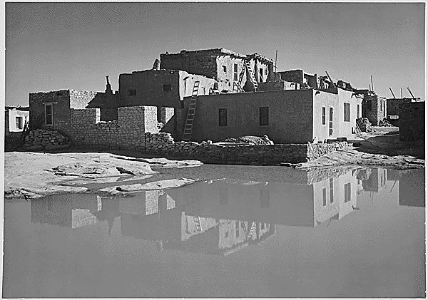
Daily Life: Acoma Pueblo
Notes:
A Native American pueblo approximately 60 miles west of Albuquerque, New Mexico in the United States. The Acoma have continuously occupied the area for over 800 years, making it the oldest continuously inhabited communities in the United States

Slide 26
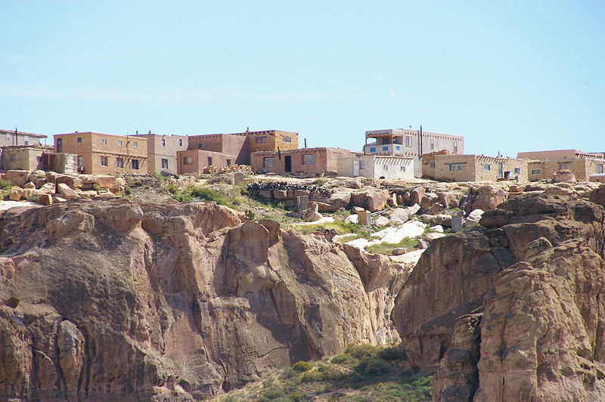
Daily Life: Acoma Pueblo
Notes:
Acoma sets atop a mesa.

Slide 27
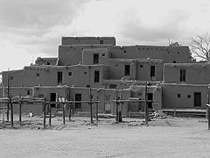
Daily Life: Taos Pueblo
Notes:
Ancient apartment-style dwellings at the Taos Pueblo, New Mexico, USA.

Slide 28
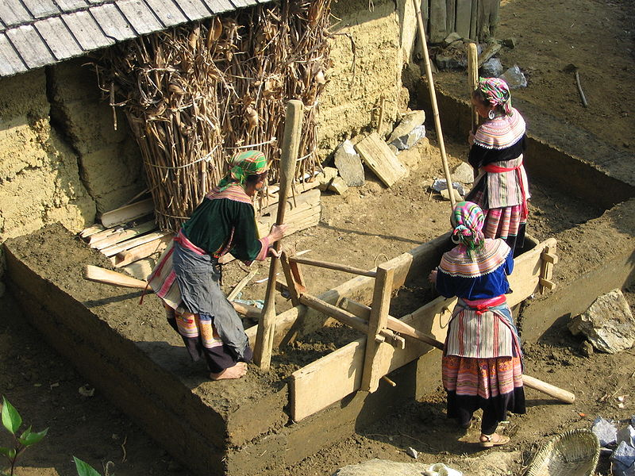
Daily Life: Housing
Notes:
A typical rammed earth house building technique of flower Hmong people in Vietnam

Slide 29
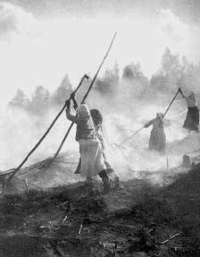
Daily Life: Slash and Burn Agriculture
Notes:
Slash-and-burn practices in Eno, Finland, 1893.

Slide 30
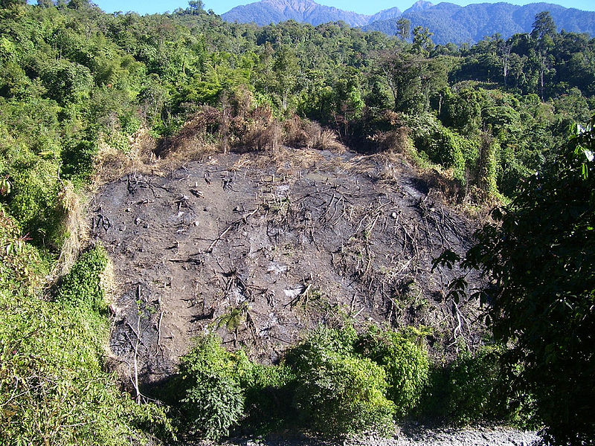
Daily Life: Slash and Burn Agriculture
Notes:
Effects of slash-and-burn on primary forest can be devastating. Seen in this photo is a patch of forest in Namdapha National Park in Northeast India cleared for Jhum cultivation

Slide 31
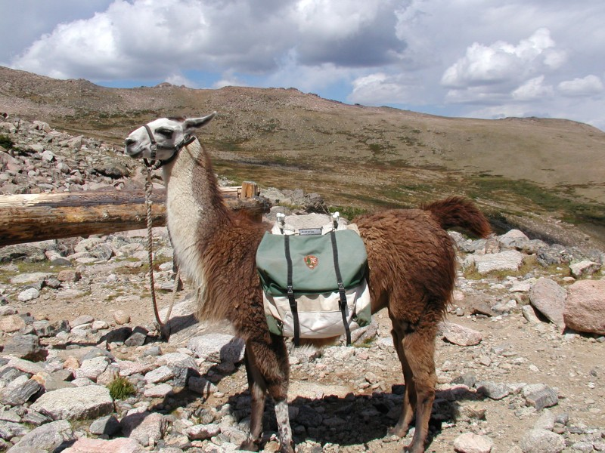
Daily Life: Llama Pack Animal
Notes:
In the Western hemisphere the llama served as a pack animal.

Slide 32
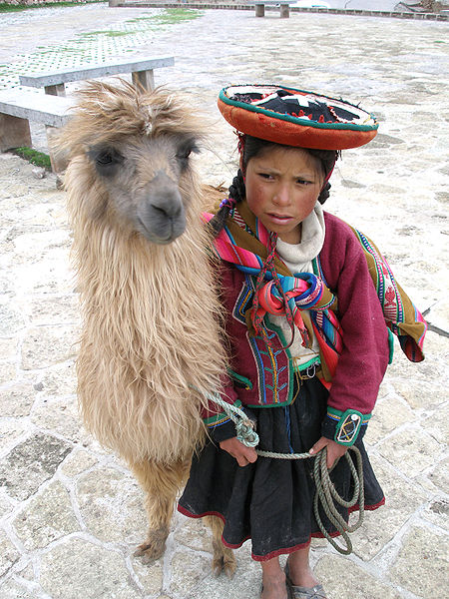
Llama, Pack
Animal
Notes:
A traditionally dressed Quechua girl with a llama in Cuzco

Slide 33
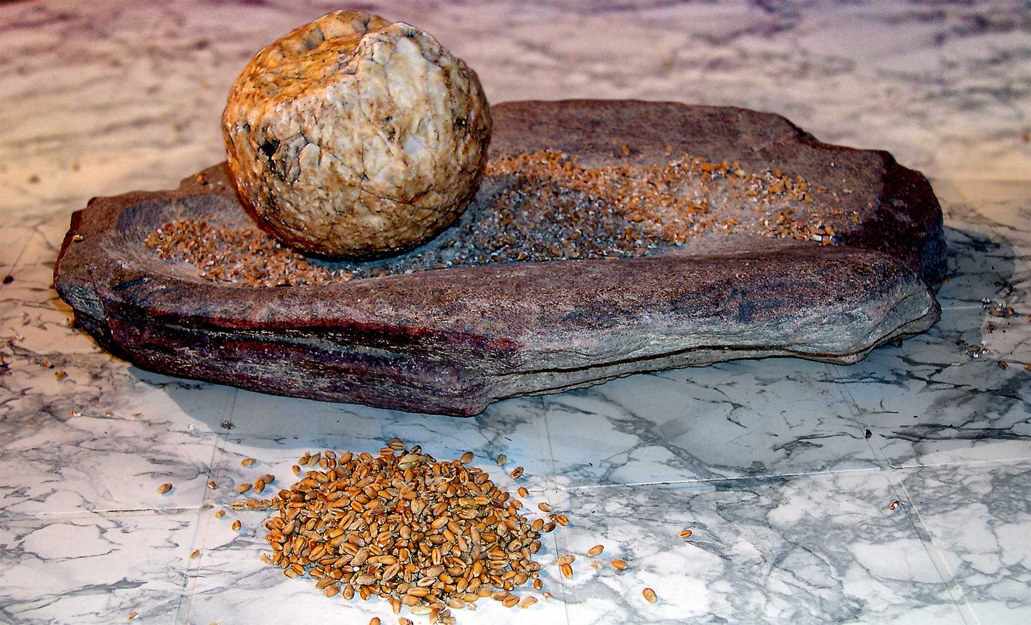
Technology: Grinding Stone
Notes:
Neolithic grindstone for processing grain.

Slide 34
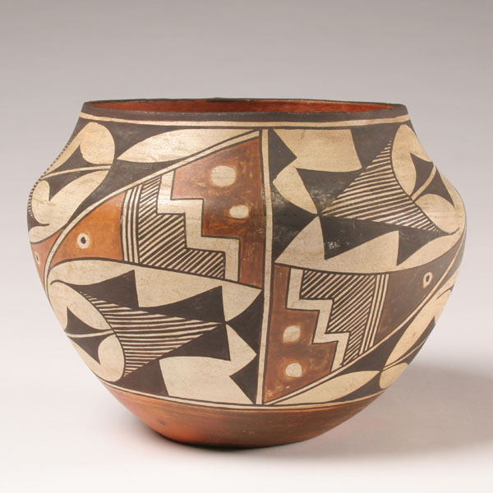
Technology: Pottery

Slide 35
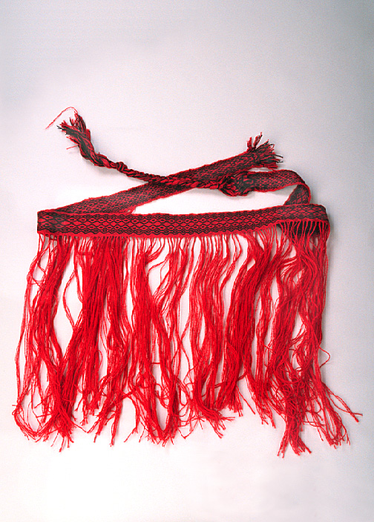
Technology: String Skirt
Notes:
This string skirt, copied from one still used in some parts of the Balkans, is based on one of the longest continuing clothing trends in the world. The evidence is from a Neolithic archeological site in Denmark, dating to 6000 BCE. Folk costumes in many countries of Eastern Europe include a version of this string skirt in the form of a fringed apron. Women have worn and still wear these aprons to communicate information about their lives and marital status. Smith College Museum of Ancient Inventions. (Do not copy, no response from request for permission to use.

Slide 36
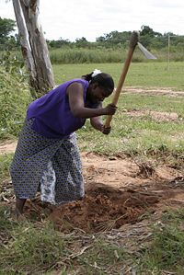
Patterns of Labor: Horticulture
Notes:
Subsistence farming in Zambia, Africa. Mostly women were (are) the farmers in the Agricultural Wave

Slide 37
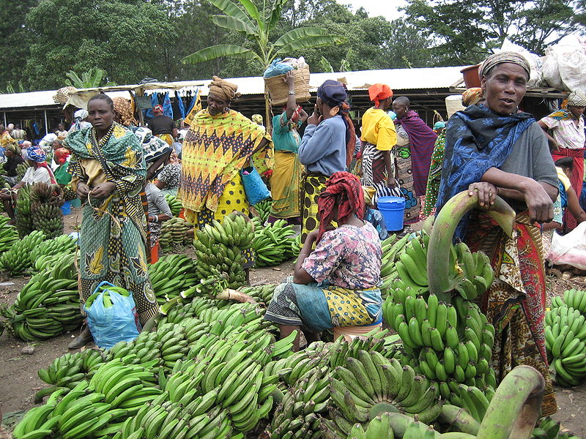
Exchange and Trade: Markets
Notes:
Tengeru market near Arusha, Tanzania

Slide 38
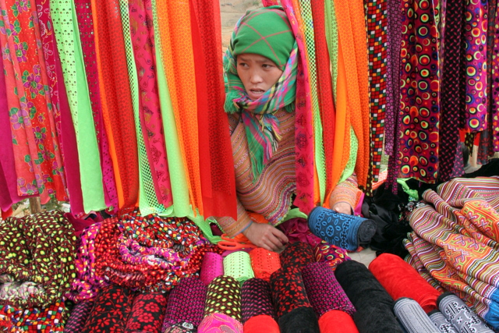
Exchange and Trade: Markets
Notes:
Colorful trade in fabrics at a local bazaar in Thailand. Roger Harmon photo, permission

Slide 39
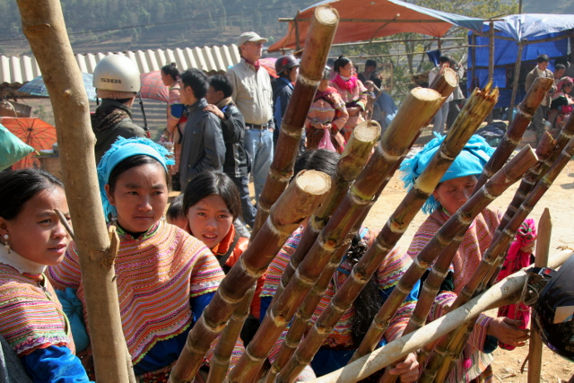
Exchange and Trade: Markets
Notes:
Market in Thailand. Photo Roger Harmon, permission.

Slide 40
Human Networks: Social Currents
Groups
Family
Gender
Prestige and Status
Socialization and Education

Slide 41
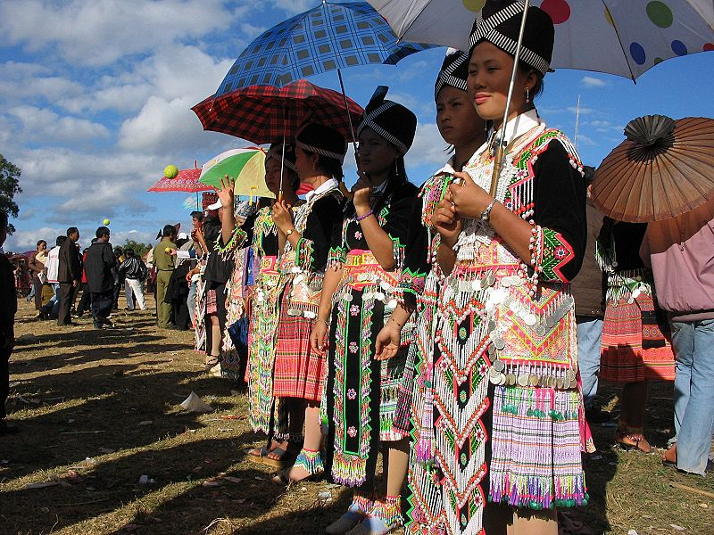
Groups
Notes:
Hmong girls meet possible suitors while playing a ball-throwing game in Laos.

Slide 42
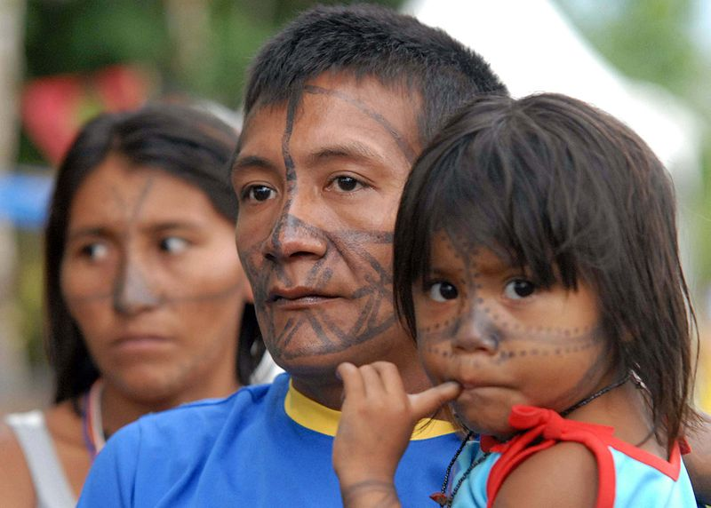
Family
Notes:
Brazilian indigenous family

Slide 43
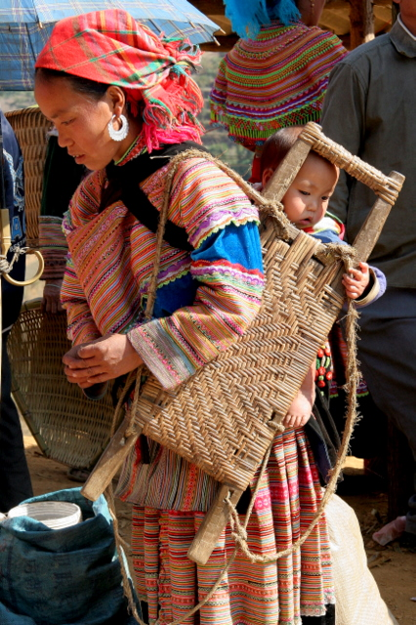
Family: Mother and Baby
Notes:
Vietnam, Hmong people

Slide 44
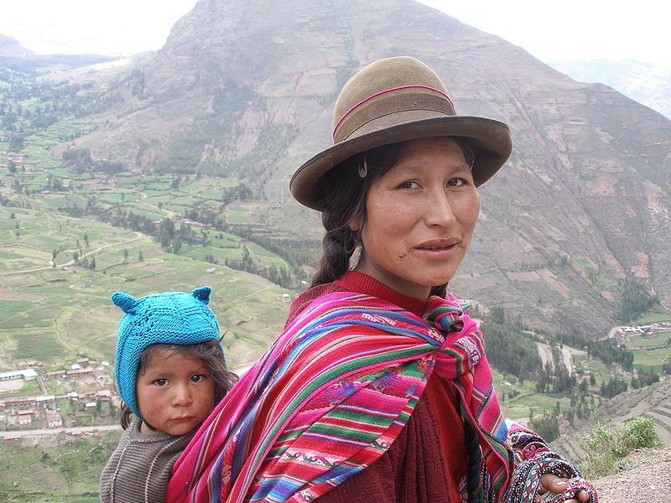
Family
Notes:
Quechua woman and child in the Sacred Valley, Andes Moutains, Peru

Slide 45
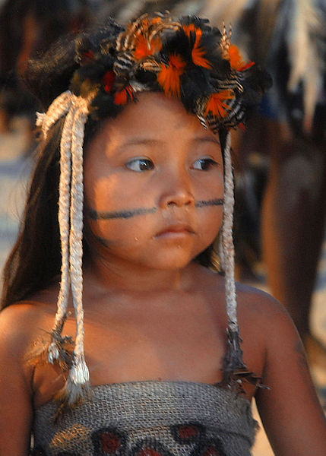
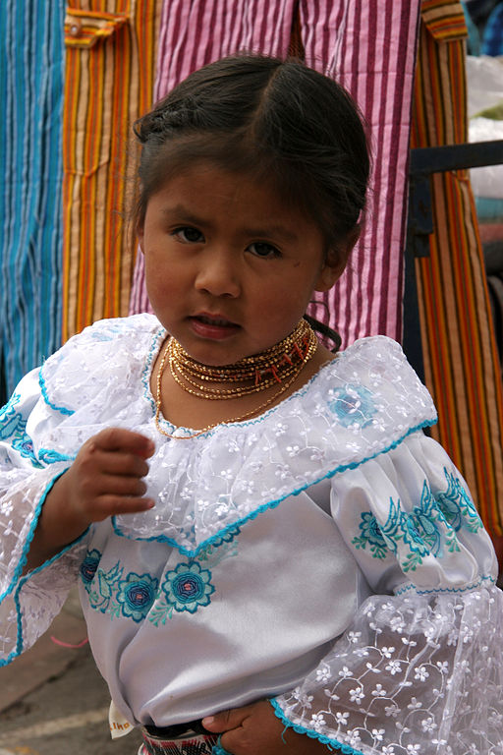
Family
Notes:
Left: Terena tribe in Brazil
Right: Otavaleña girl from Ecuador

Slide 46
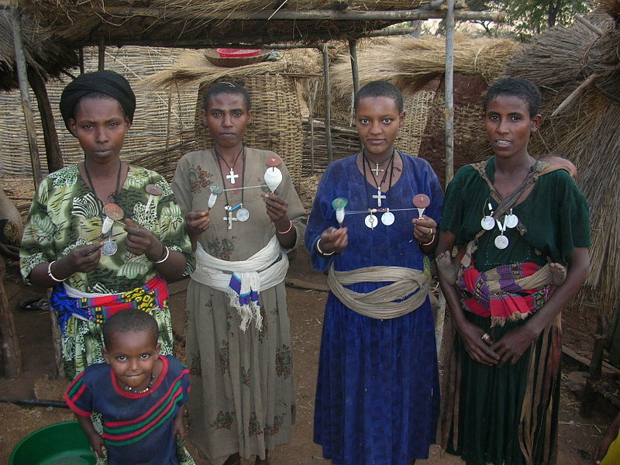
Gender
Notes:
Agaw women holding spindles for hand-spinning yarn. Ethiopia, Africa

Slide 47
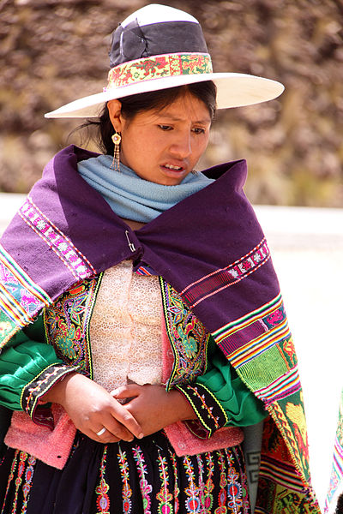
Gender
Notes:
Amerindian woman in traditional dress, near Cochabamba, Bolivia.

Slide 48
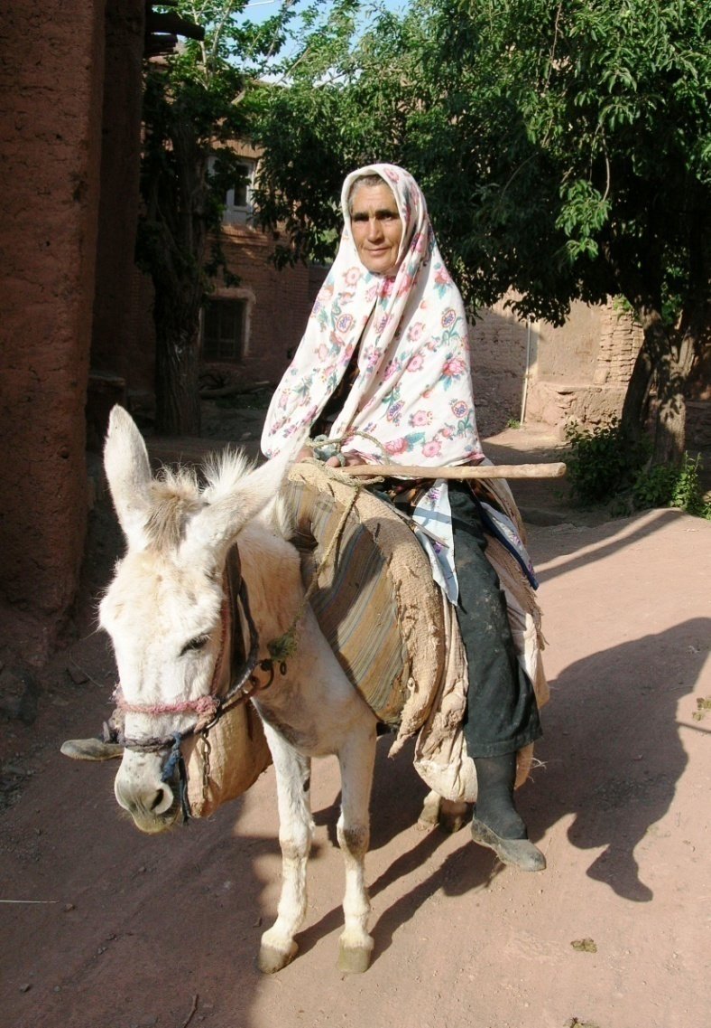
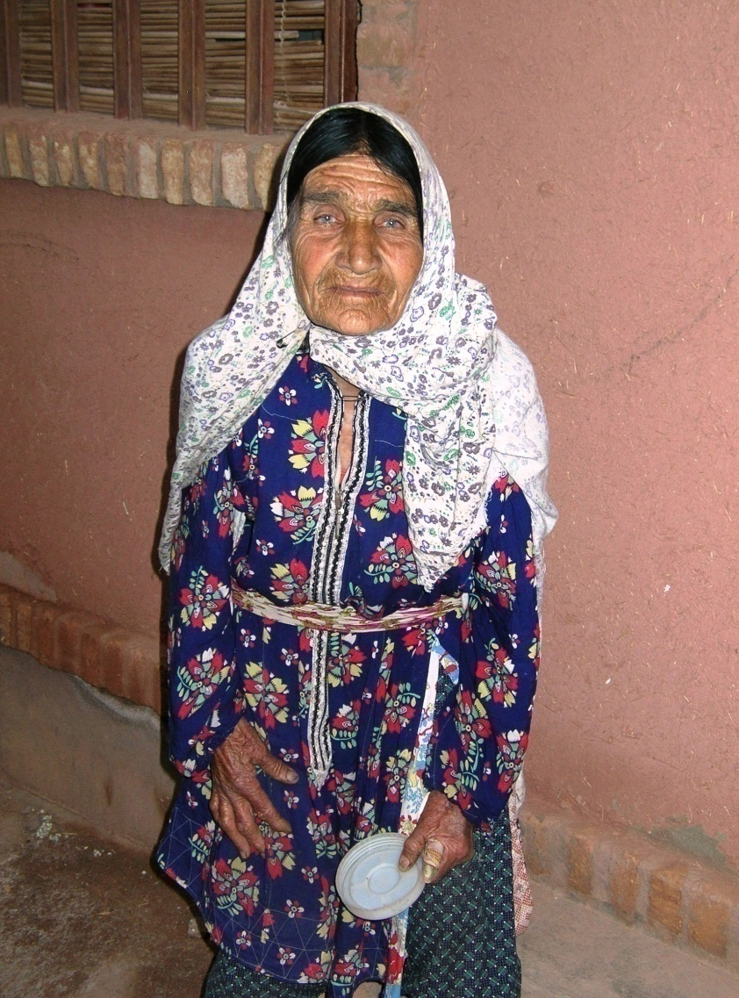
Gender
Notes:
Iranian women in the village of Abyaneh.

Slide 49
Establishing Order:
Political Currents
Leadership
Political Systems
Customs, Rules, and Laws
Migration and Interaction
Conflict, Cooperation and War

Slide 50
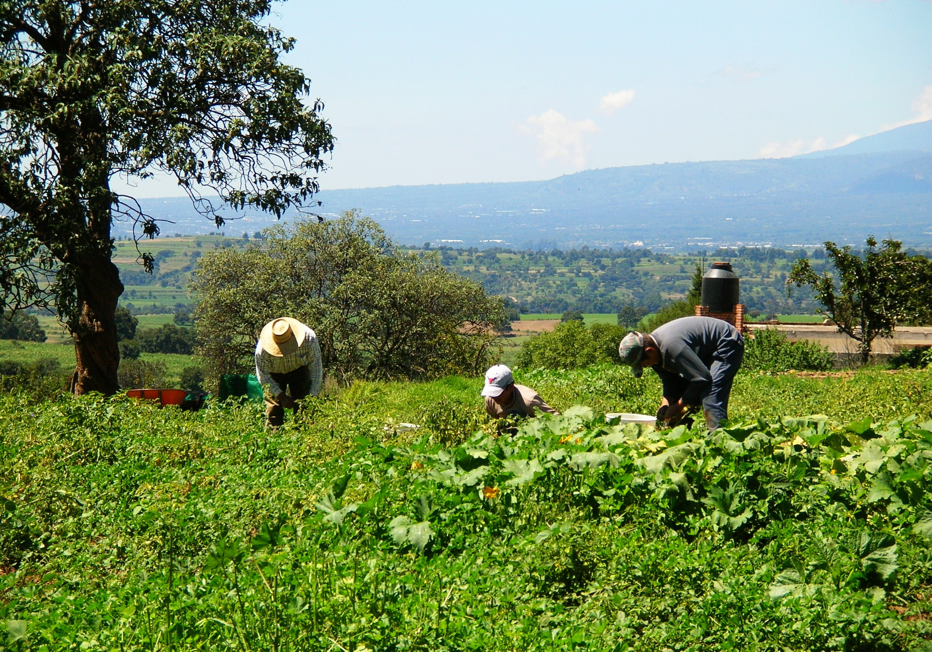
Cooperation
Notes:
Cooperation. Working the ejido in the village of Vincente Guerrero, Mexico. Photo Denise Ames

Slide 51
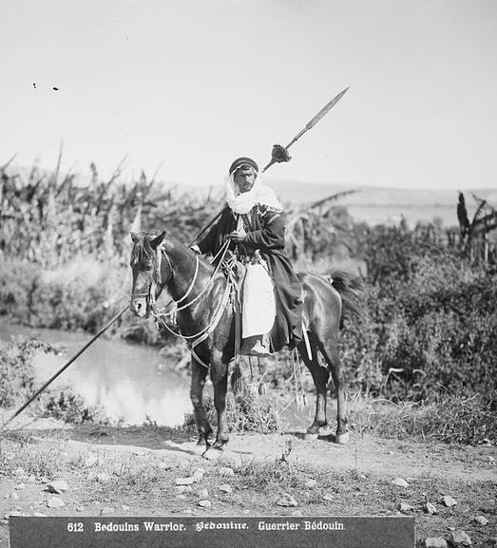
Warfare
Notes:
A northern Arab tribal warrior (ca. 1914) carrying a large Beduine hunting az-zaġāyah on horseback during the Ottoman era of Transjordan.

Slide 52
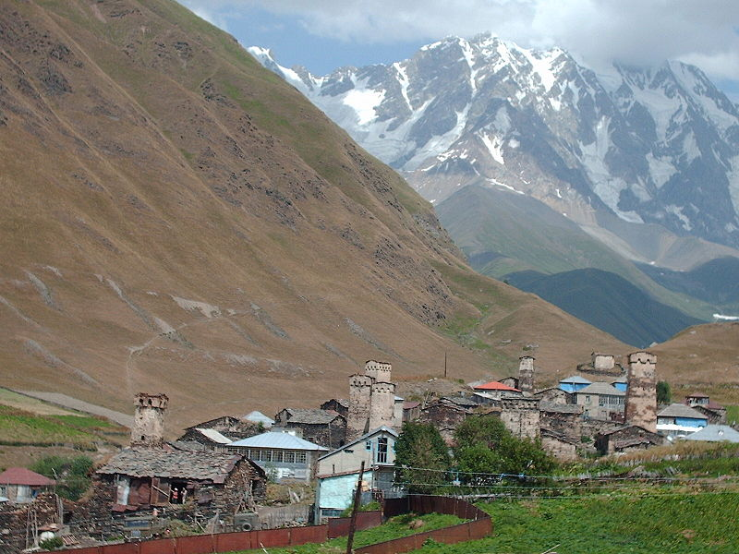
Conflict
Notes:
The defensive towers built by feuding clans of Svaneti in the Caucasus Mountains of Eastern Europe. Wikimedia Commons

Slide 53
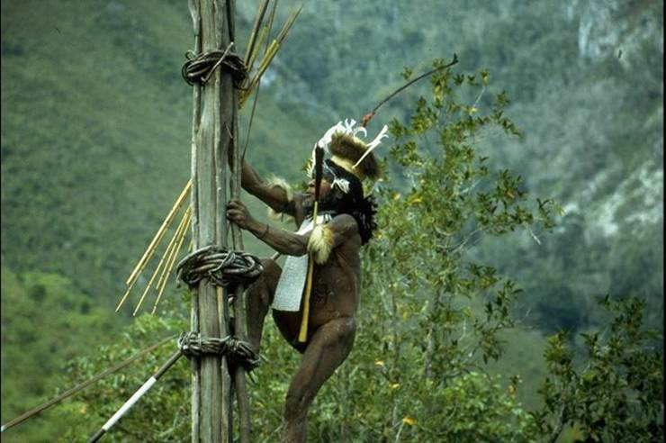
War Chief
Notes:
Kurulu Village War Chief at Baliem Valley, New Guinea. Wikimedia Commons

Slide 54
Human Expressions:
Cultural Currents
Worldview, Ideology
Religion and Spirituality
Communication
Identity and Belonging
Aesthetic Expression

Slide 55
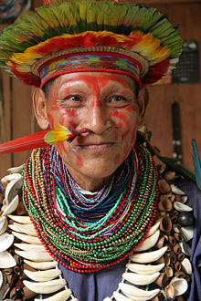
Spirituality: Shaman
Notes:
Shaman from equatorial Amazon rain forest.

Slide 56
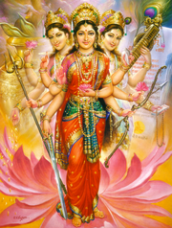
Religion
Notes:
The Tridevi. The conjoined image of three especially popular manifestations of the Hindu Divine Mother: Lakshmi (wealth/material fulfillment), Parvati (Power/love/spiritual fulfillment), and Saraswati (learning and arts/cultural fulfillment), left to right. Hinduism has folk religion (prehistoric) roots.

Slide 57
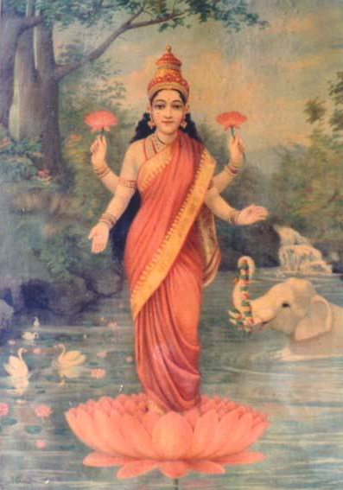
Religion
Notes:
The goddess Lakshmi. Lakshmi, is one of the most popular and widely worshiped Goddesses in Hindu tradition since pre-Buddhist period. She has a considerable body of mythology and history. The earliest legend states that Sri is born as a result of austerities of Prajapati, and she represents ten qualities and objects, namely, food, royal power, universal sovereignty, knowledge, power, holy luster, kingdom, fortune, bounteousness, and beauty.

Slide 58

Spirituality: Shaman
Notes:
South Moluccan Shaman exorcising evil spirits occupying children, Buru. 1920.

Slide 59


Aesthetic Expression
Notes:
Left: Image of a sitting Goddess, Inanna, which supports the contention that the Goddess represents Mother Earth.

Slide 60

Aesthetic Expression
Notes:
A figure often interpreted as a Mother Goddess flanked by two lionesses - 6000-5500 BC Çatalhöyük, Turkey

Slide 61

Aesthetic Expression
Notes:
Folk festivals such as the one in Ecuador were common in agricultural villages. photo Roger Harmon

